Slide 1
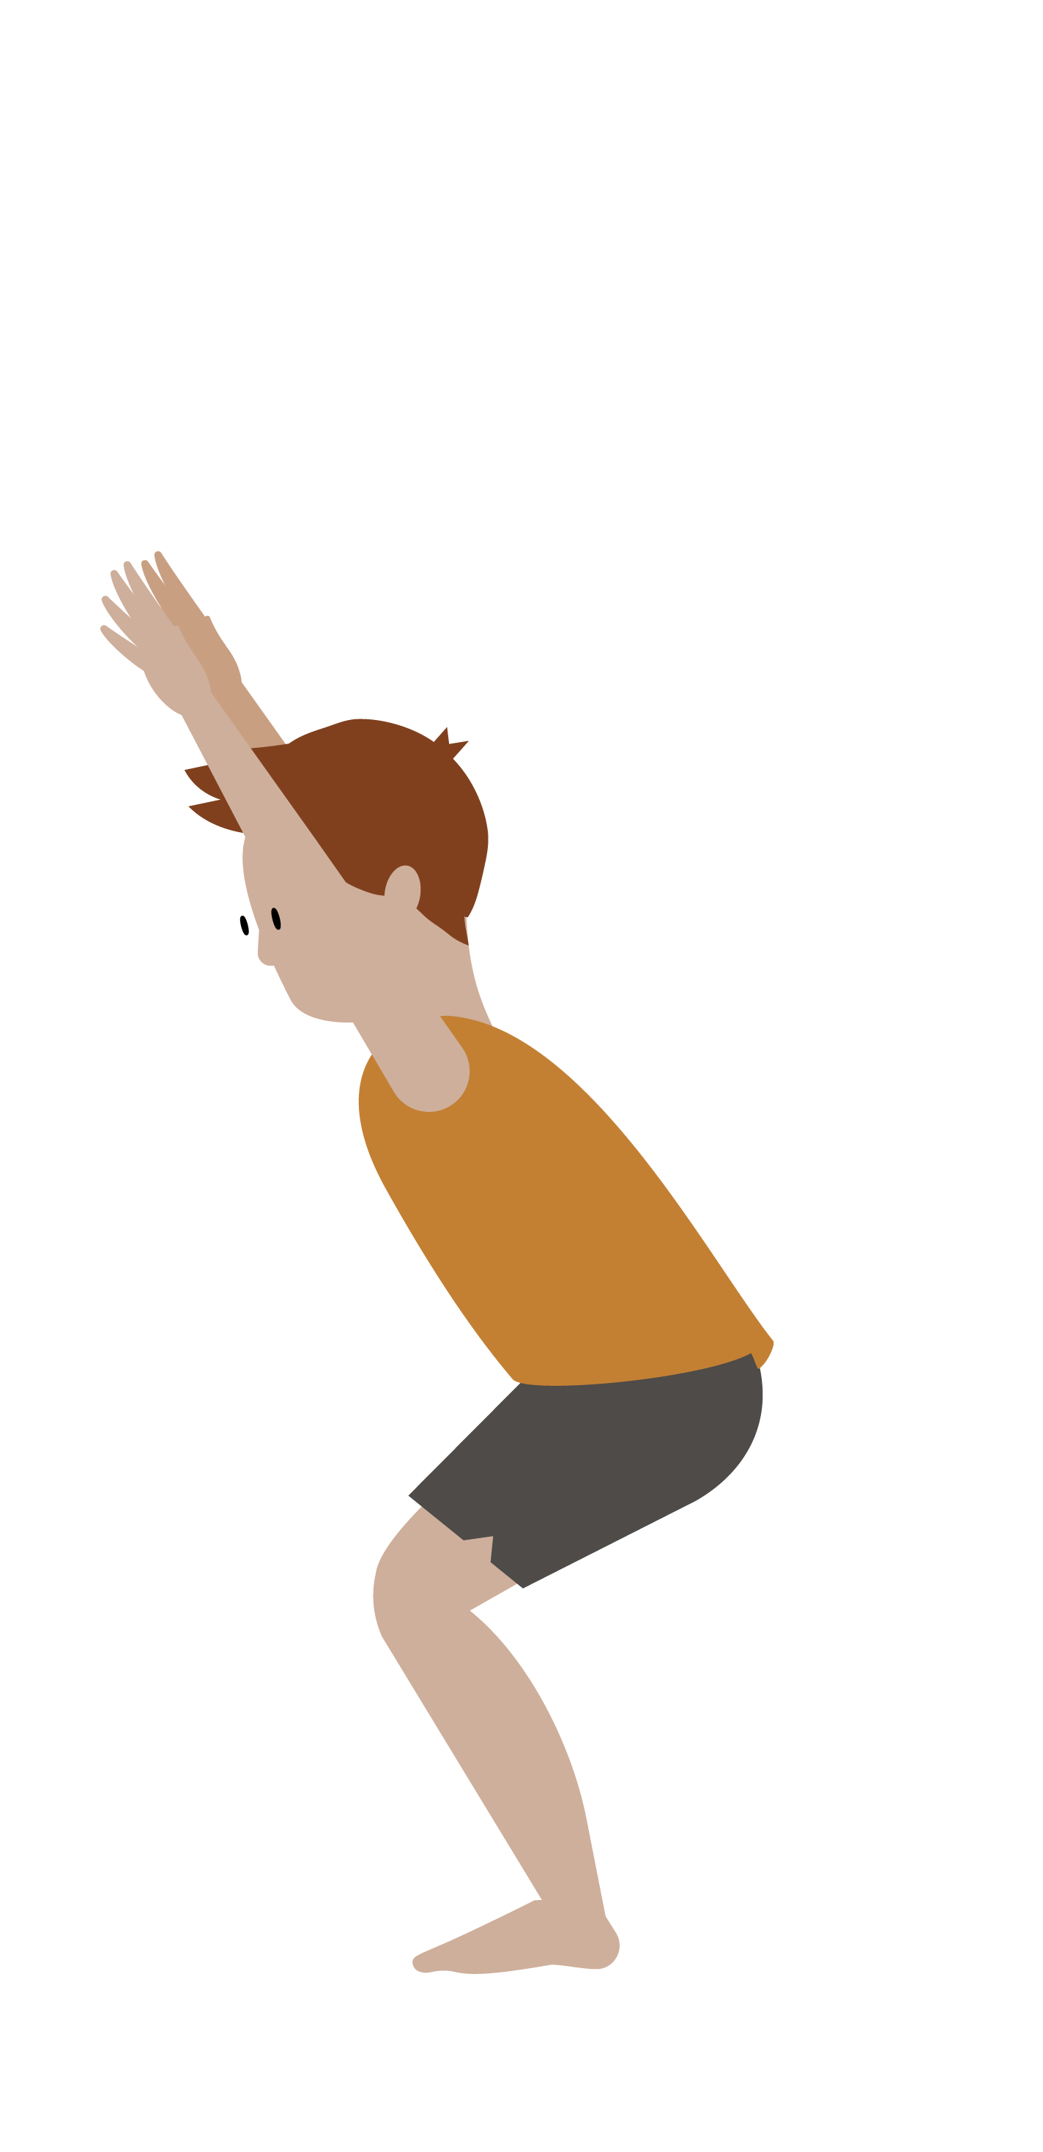
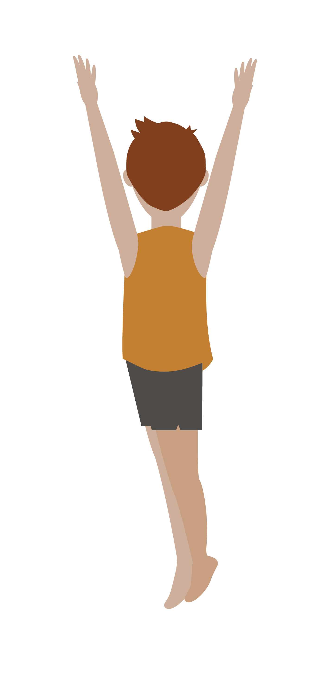
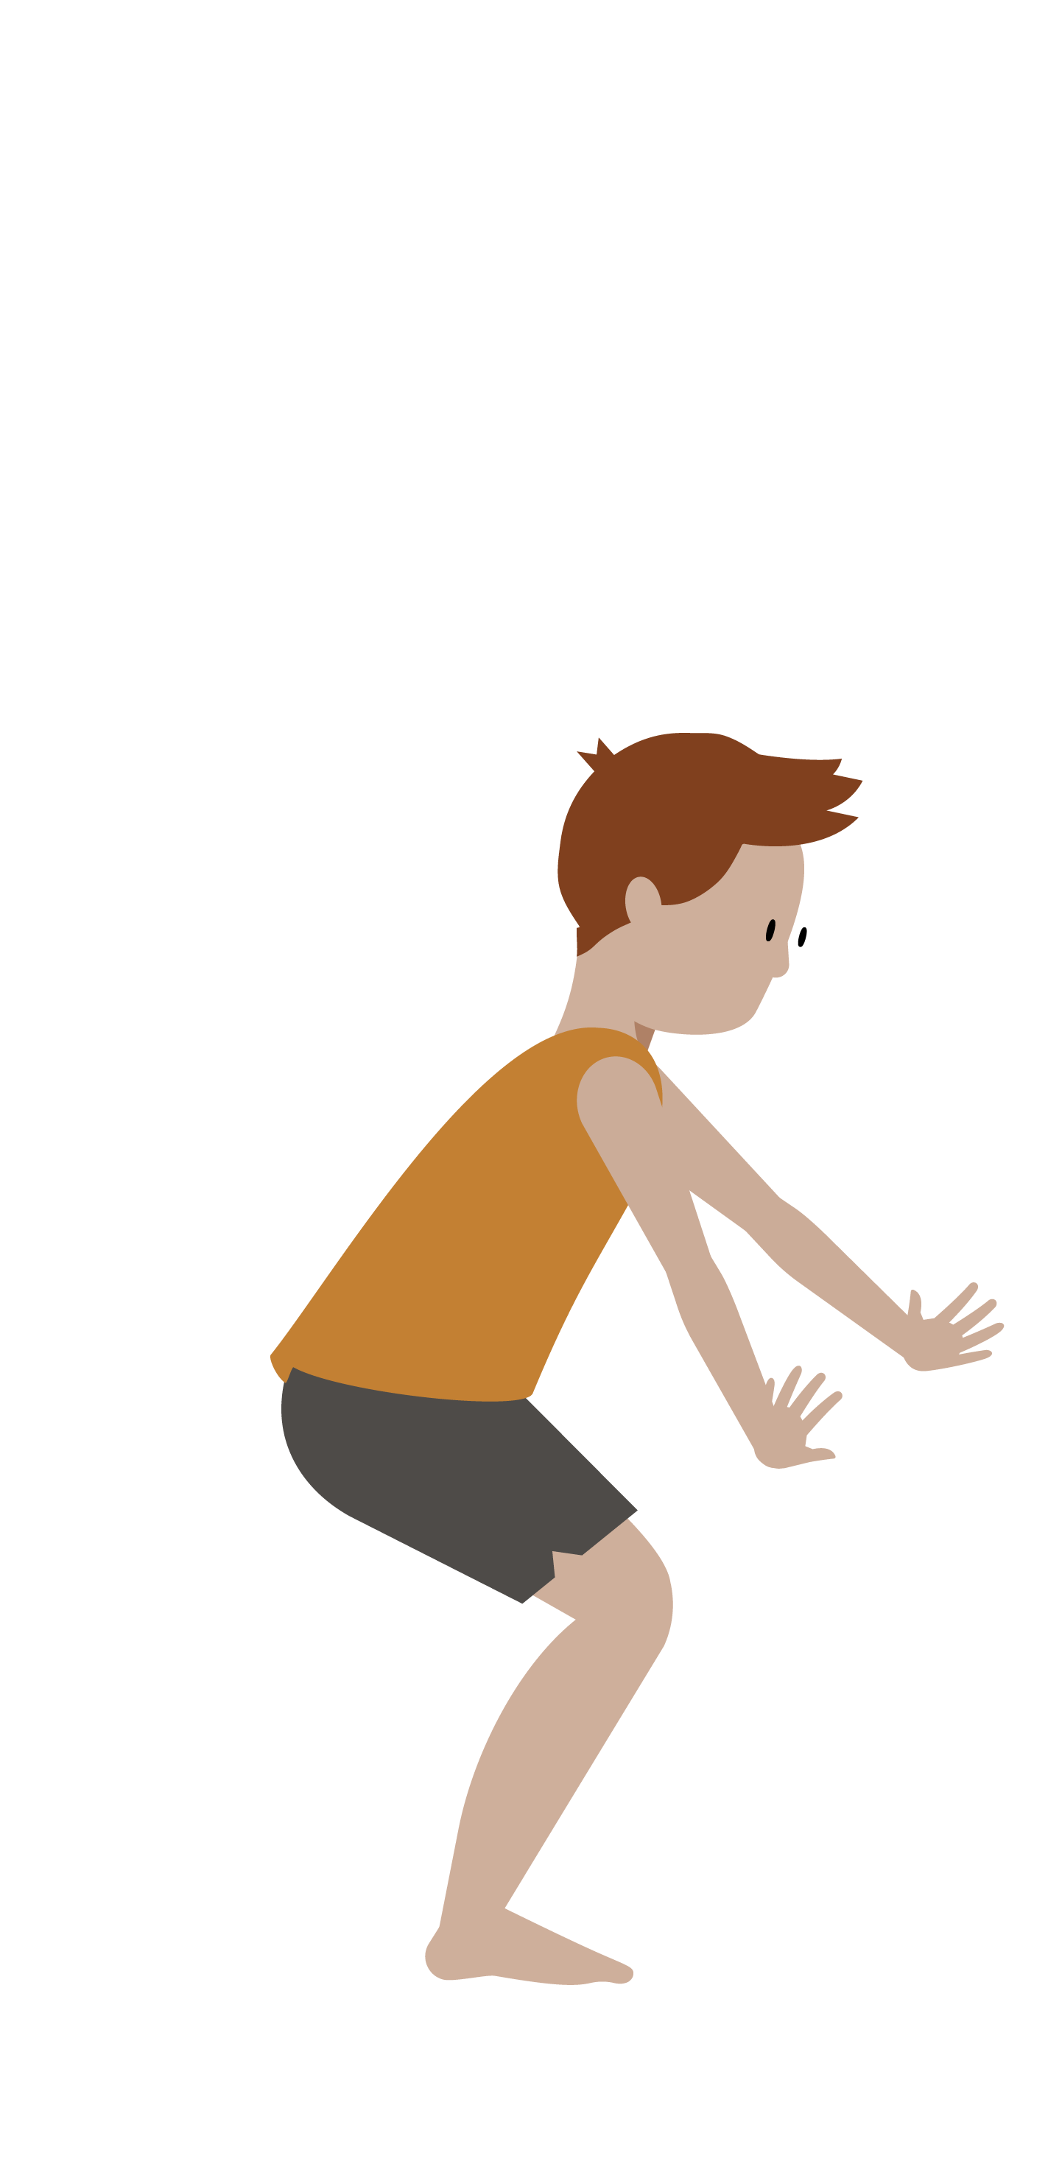
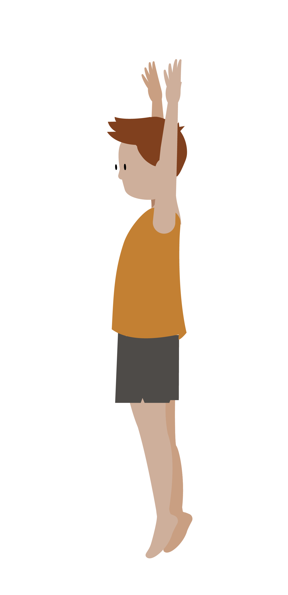
Jump turns /twist
Teaching points
Start in a straight shape; arms extended above your head
Bend slightly at the knees to generate power for the jump
As you jump, push away with your feet in the direction you wish to turn
Keep arms above the head throughout the twist
Land on soft knees in the magic chair position
Return to standing with arms extended in straight positions
Start with turning a quarter, when this is secure, move onto half twist

