Slide 1
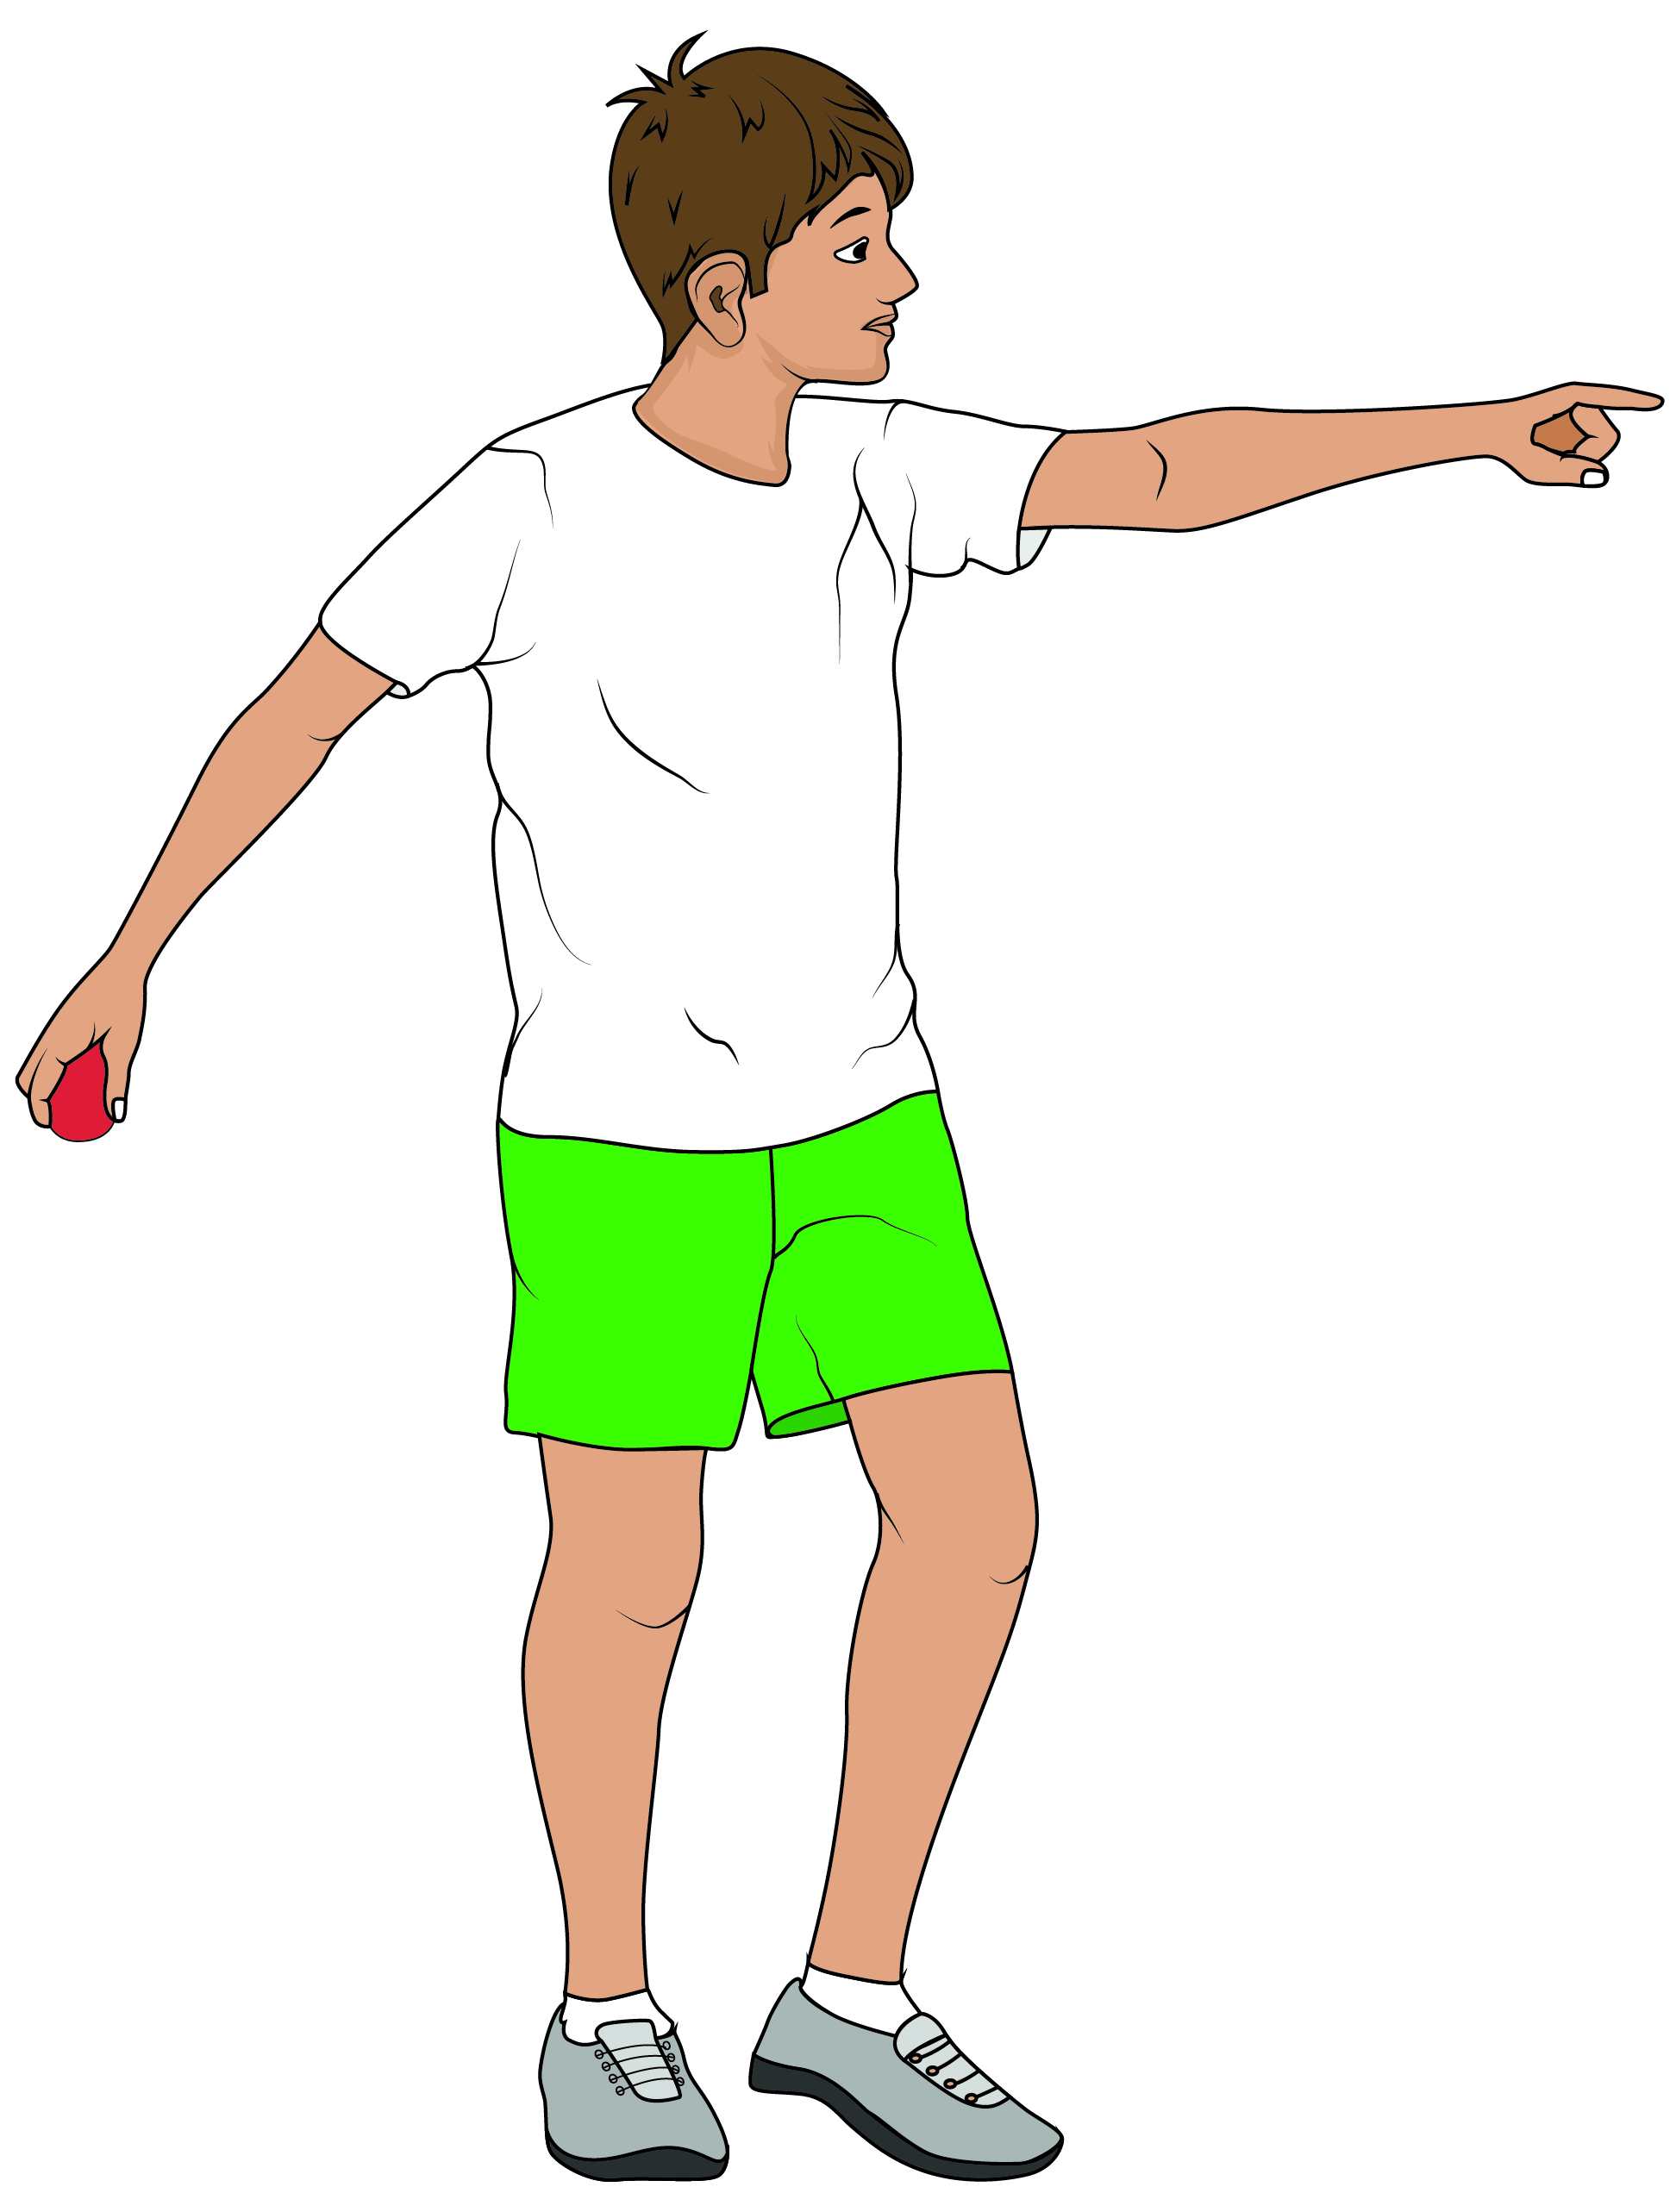
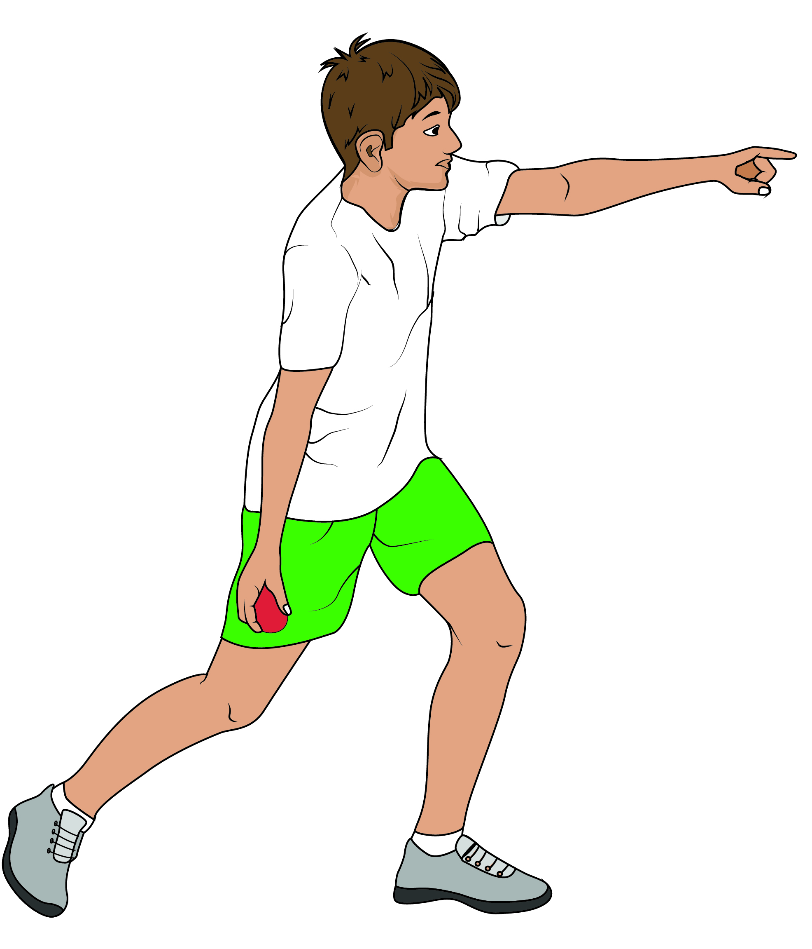
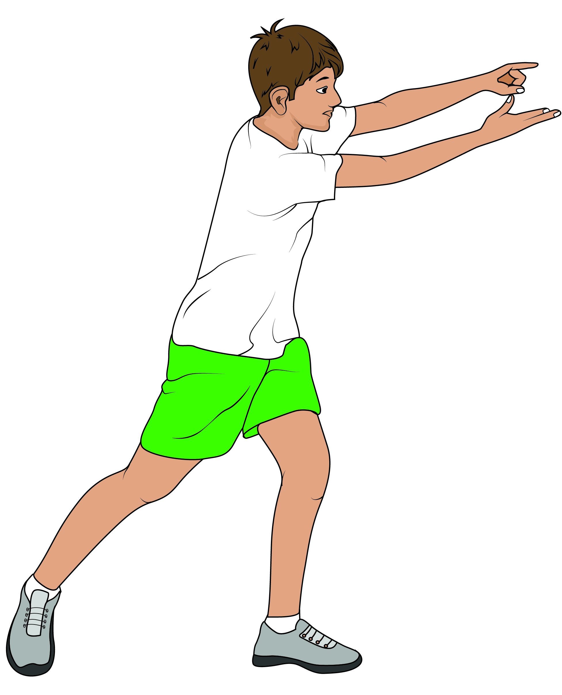
Underarm Bowling
Why? A method of delivering the ball for a batter to hit that is easy to control and accurate.
Teaching points
Step in with the opposite foot to the bowling hand.
The non-bowling hand should be pointing in the direction of where the ball is to be bowled.
With a backswing, the hand should end up pointing at the target.
Reinforce to the pupils that the ball will travel in the direction that the arm is pointing.
To create power, increase backswing and take a bigger step.
1
2
3

