Slide 1
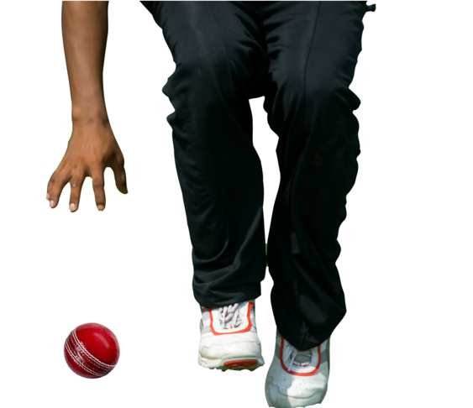
Intercepting with one hand
Why? Stopping a moving ball using a one-handed technique allows a fielder to return the ball quicker than using a long barrier.
Teaching points
Watch the ball closely as it approaches you. Focus on the ball's trajectory and speed.
The lead foot steps as close to the ball as possible to make collecting the ball easier, e.g. if you are collecting the ball with your right hand the right foot should be placed close to the ball
Get into the best possible position to intercept the ball with one hand. Extend your arm towards the ball, keeping your fingers pointing down and your palm facing the ground.
Grip the ball firmly your hand is behind the ball, with your fingers spread wide to cover as much surface area as possible.
After intercepting the ball, maintain your balance by keeping your feet planted and your body stable. This will allow you to quickly transfer the ball to your throwing hand if necessary.

