Slide 1
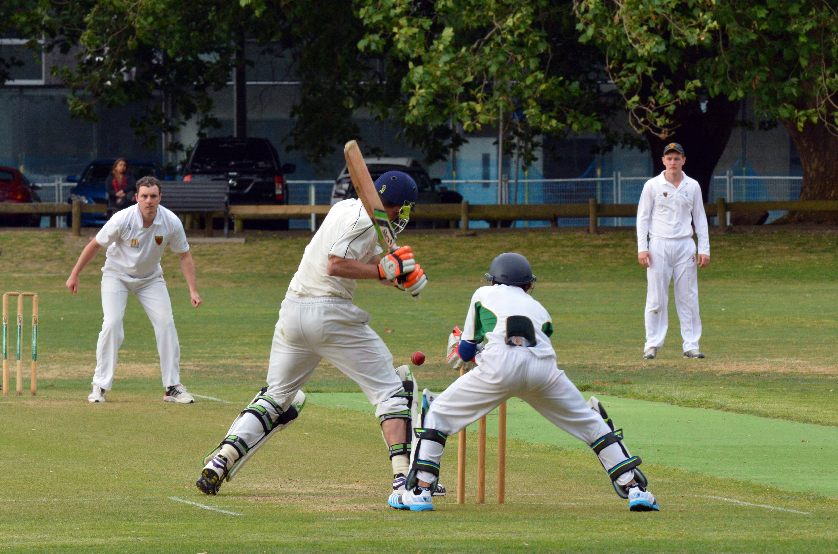
Fielding at mid-on/mid-off
Why? The job of a mid-off/mid-on fielder is to stop the ball when driven straight by the batter. They cover shots played within the ‘V’, which includes space directly behind the bowler. There are 3 variations of the mid-off/mid-on position, each with slightly different roles.
What are ’fielding positions’?
In a proper game of cricket, every fielder is given a position to cover in the field.
Each position has a unique role in managing the game and is identified by a different name.
Don't forget that the group already knows about two positions: the bowler and the wicketkeeper.
Mid-off
(fielder)
Bowler (fielder)
Wicketkeeper (fielder)

Slide 2
What is the on and off side?
A cricket pitch is divided into two imaginary halves. One half is called the ON side, and the other half is called the OFF side. So when you are asked to field at ‘mid-on’, you know that you must stand on the ON side of the pitch, and if you are fielding at ‘mid-off’, you are fielding on the OFF side of the pitch.
Important!
Because the halves are imaginary, the can be changed. And they change depending on whether the batter is left or right-handed. The fielders adjust their positions depending on whether the batter is left or right-handed.
*90% of people are right-handed, so there is not too much switching the field!*
On side
Off side
Off side
On side
Right-handed batter
Left-handed batter

Slide 3
Fielding at mid-on/mid-off
There are 3 variations of the mid-off/mid-on position, each with slightly different roles.
On side
Off side
Mid-On/Off – when a fielder is positioned straight about 25 yards away from the batter. They are there to stop any quick singles by the batters after a drive shot is played.
1
Long-On
Long-Off
Mid-On
Mid-Off
2
Silly Mid-On/Off – when a fielder is positioned straight, very close to the bat. They are there to catch any balls hit in the air that stay close to a batter.
Silly Mid-On
Silly Mid-Off
Right-handed batter
Long-On/Off – when a fielder is positioned straight next to the boundary. They are there to stop any boundaries from being hit by a batter playing a drive shot.
This picture shows the fielding positions for a right-handed batter. Remember the on-side and off-side of the pitch swap depending on whether a batter is left or right-handed.
3

